Slide 1

Project Presentation Phase II
Review 2
AI-Powered Real-Time Urban Traffic Congestion Prediction Using Distributed Big Data Processing
Project Team – Group 01
ADARSHA G C (1DB22CS003)
DINESH S (1DB22CS040)
SANKETH N (1DB22CS193)
SUDHARSHAN (1DB23CS415)
Guided By:
Dr K B SHIVA KUMAR BE, ME, MBA, MPhil, PhD
Professor and Head
Dept of CSE

Slide 2
Agenda
Introduction
Problem Statement
Aim and Objective of the Project
Literature Survey
System Analysis and Design
Implementation and Testing
Result and discussion
Conclusion and Future scope
References

Slide 3
Introduction Smart cities aim to enhance the quality of life by integrating advanced technologies into urban infrastructure. Among the many challenges faced in this domain, traffic congestion remains a primary concern. Rapid urbanization and increasing vehicular load strain existing road networks, leading to extended travel times, environmental degradation, and economic loss. Traditional prediction models often fall short due to their limited scope and inability to incorporate diverse data types. To address this, our project introduces a novel predictive framework that utilizes data from various sources including GPS devices, weather APIs, and mapping services processed through a hybrid deep learning approach. This method enables accurate and timely forecasting of traffic congestion, contributing to more efficient urban mobility solutions.

Slide 4
PROBLEM STATEMENT
Urban areas are experiencing heightened traffic congestion, which leads to significant delays, resource wastage, and economic drawbacks. Predicting traffic patterns is complicated by the dynamic and multifaceted nature of contributing factors such as weather, road conditions, time of day, and vehicular flow. There is a pressing need for a robust, scalable, and intelligent traffic forecasting system that can accommodate the spatial-temporal complexities of urban transport networks.

Slide 5
AIM To develop a robust, scalable, and intelligent traffic forecasting system capable of integrating and processing data from multiple heterogeneous sources, effectively addressing the spatial-temporal complexities of urban transport networks. The system should leverage advanced machine learning techniques and real-time data analytics to enhance the accuracy of traffic predictions, optimize vehicular flow, minimize congestion-related delays, and improve overall urban mobility and resource efficiency.
Objectives To develop a traffic prediction model that accurately forecasts congestion levels on city roads. To design and implement a deep learning framework for enhanced spatial-temporal traffic analysis. To integrate heterogeneous data sources including speed and road network characteristics To evaluate the performance of the proposed model against traditional machine learning methods. To provide actionable insights for traffic management systems in smart city infrastructure.

Slide 6
LITERATURE SURVEY
Title | Authors | Published Year | Methodology | Limitations
Traffic Prediction in Smart Cities Based on Hybrid Feature Space | N. Zafar et al. | 2022 | Hybrid GRU-LSTM model using heterogeneous data sources | Limited to Islamabad city data; high preprocessing complexity
A Comprehensive Evaluation of Deep Learning-Based Techniques for Traffic Prediction | J. Mena-Oreja and J. Gozalvez | 2020 | Survey of deep learning models including CNNs, RNNs, LSTM, GRU | Lacks real-world deployment examples
AI-Driven Traffic Congestion Management | S. P. S. Rathore et al. | 2025 | Predictive analytics with AI-based congestion models | Focuses more on conceptual framework, lacks model specifics
AI-Powered Traffic Management | M. D. Malathi et al. | 2025 | AI for congestion detection and signal regulation using ML | Limited dataset scalability

Slide 7
Enhancing Traffic Flow with IoT-based Intelligent Traffic System | M. H. Kabir and M. S. Islam | 2024 | IoT integration with intelligent traffic management | Security and integration challenges
Entropy-Based Traffic Flow Labelling | M. Z. Mehdi et al. | 2022 | CNN model using entropy-based feature labelling IoT-enabled traffic signal manipulation for emergency | Doesn’t consider dynamic road conditions
IoT-Based Traffic Control System for Emergency Vehicles | K. P. Kavitha et al. | 2024 | IoT-enabled traffic signal manipulation for emergency | Limited to emergency vehicle focus

Slide 8
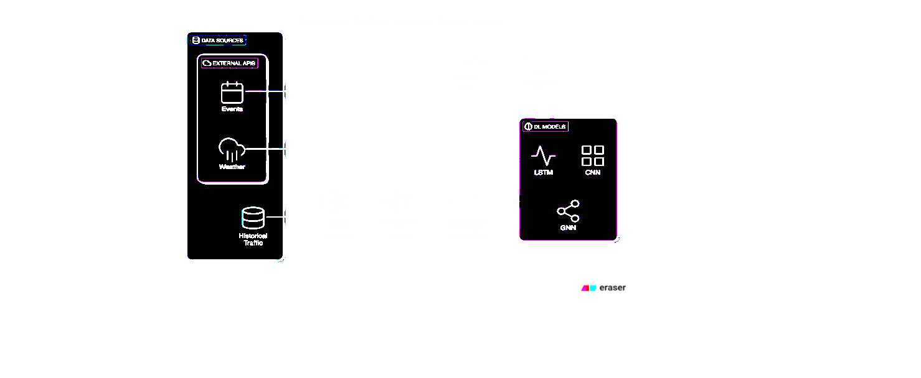
PROPOSED MODEL

Slide 9
System Analysis and Design
The system aims to predict real-time urban traffic congestion using deep learning and big data processing.
It follows a structured pipeline:
Data Acquisition – Real-time data from APIs like TomTom (speed, travel time, coordinates).
Preprocessing – Handles missing values, normalizes data, aligns timestamps, and creates time windows.
Feature Engineering – Adds derived features like speed variability, hour-of-day, weekday/weekend.
Model Design – Evaluates models such as LSTM, GRU, Random Forest, and hybrid networks.
Evaluation – Uses metrics like MSE, RMSE, MAE, and R² to assess performance.
The architecture integrates Apache Kafka (for ingestion) and Apache Spark (for distributed stream processing).

Slide 10
Implementation and Testing
Implemented using real-time traffic data retrieved from the TomTom API.
Training and validation split: 80% training, 20% validation.
The LSTM model was trained in a sequence-to-one setup using historical and derived traffic features.
Testing was performed on multiple models (LSTM, GRU, Random Forest).
Evaluation metrics included MSE, RMSE, MAE, and R² for accuracy and error analysis.
LSTM achieved the best results — MSE: 0.0438, RMSE: 0.209, MAE: 0.160, R²: 0.88.

Slide 11
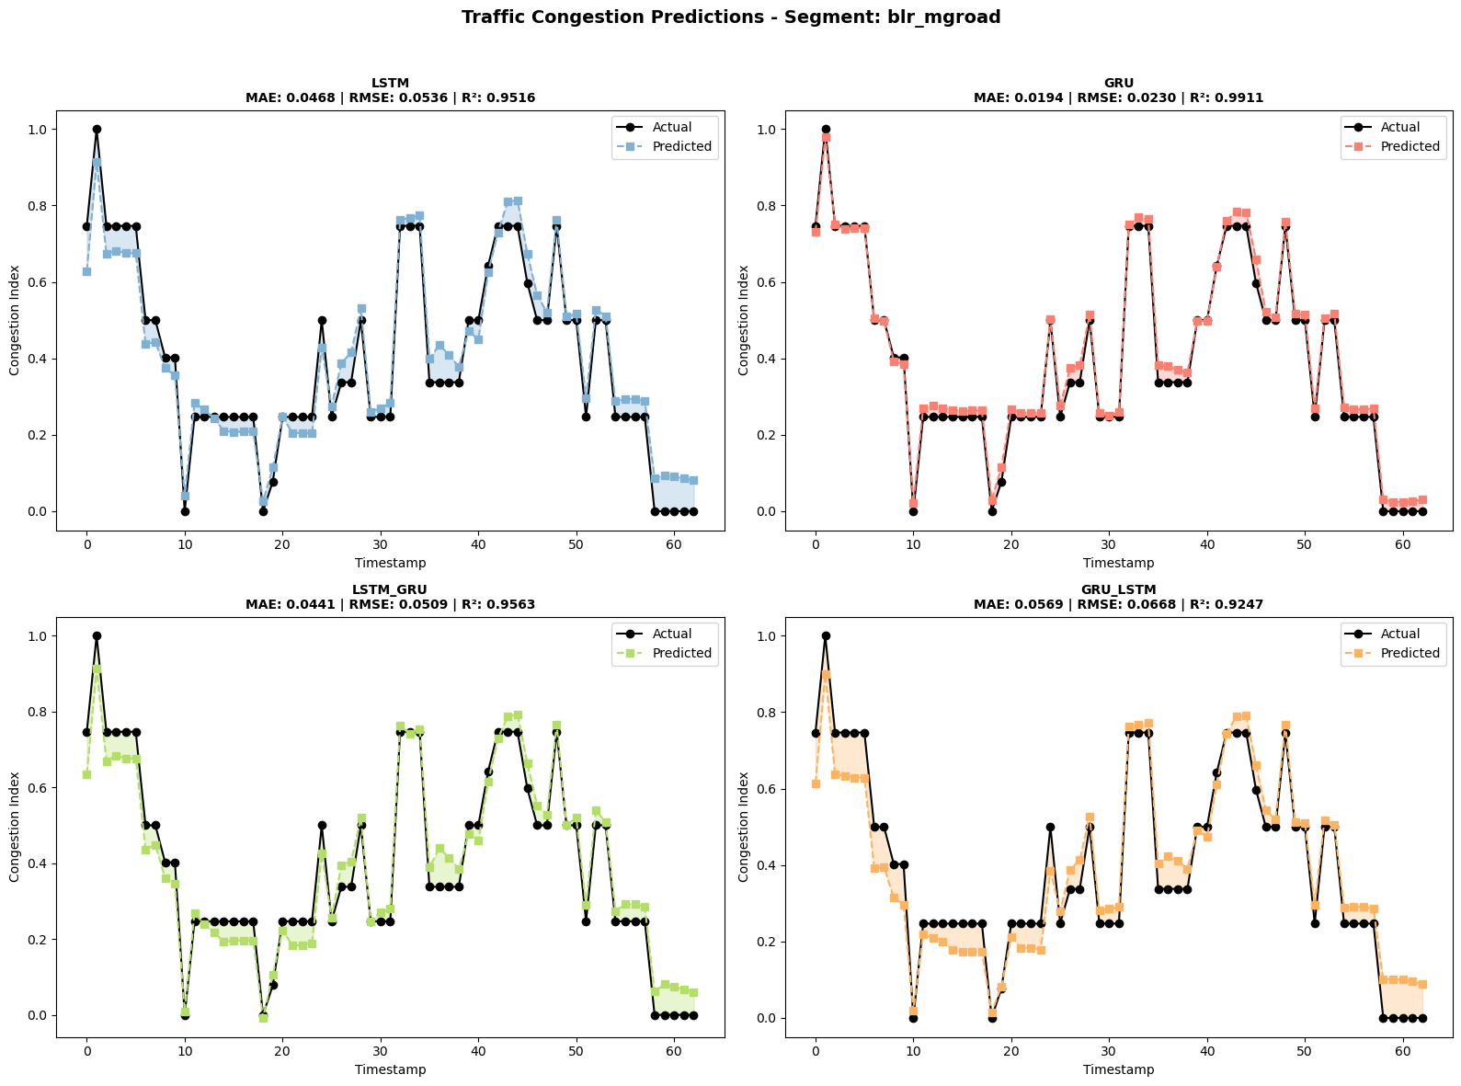
Results and Discussion
GRU provided the most stable and accurate congestion predictions compared to LSTM and Hybrid models.
LSTM captured short-term traffic fluctuations but struggled with sudden congestion peaks.
Hourly traffic patterns revealed moderate congestion between 9:00–10:30 AM, with average speed 17–18 km/h.
Visual analysis confirmed a negative correlation between speed and congestion index.
Overall, the deep learning-based models outperformed classical ML approaches in predicting spatiotemporal traffic behavior.

Slide 12
Conclusion and Future Scope
A real-time traffic congestion prediction system using deep learning was successfully designed and tested.
It effectively forecasts congestion levels to assist urban traffic management and route optimization.
Integration of LSTM and GRU models captured temporal traffic dependencies efficiently.
Future work includes:
Incorporating Transformer-based models for improved prediction accuracy.
Developing interactive dashboards for visualization and alerts.
Scaling the system to multi-city or nationwide smart city frameworks.
Exploring reinforcement learning for adaptive traffic control and signal optimization.

Slide 13
REFERENCE
[1] N. Zafar, I. U. Haq, H. Sohail, J.-U.-R. Chughtai, and M. Muneeb, “Traffic Prediction in Smart Cities Based on Hybrid Feature Space,” IEEE Access, vol. 10, pp. 134333–134347, Dec. 2022, doi: 10.1109/ACCESS.2022.3231448.
[2] J. Mena-Oreja and J. Gozalvez, “A Comprehensive Evaluation of Deep Learning-Based Techniques for Traffic Prediction,” IEEE Access, vol. 8, pp. 91188–91224, May 2020, doi: 10.1109/ACCESS.2020.2994415.
[3] S. P. S. Rathore, Y. Farhaoui, T. Nagpal, T. M., E. E. Aniebonam, and P. Kaushik, “AI-Driven Traffic Congestion Management: A Predictive Analytics Approach for Smart Cities,” in Proc. IEEE Int. Conf. Interdisciplinary Approaches in Technology and Management for Social Innovation (IATMSI), 2025, doi: 10.1109/IATMSI64286.2025.10985513.
[4] M. D. Malathi, F. Alaswad, B. Aljaddouh, L. Ranganayagi, and S. R. Sangeetha, “AI-Powered Traffic Management: Improving Congestion Detection and Signal Regulation,” in Proc. Int. Conf. Multi-Agent Systems for Collaborative Intelligence (ICMSCI), 2025, pp. 899–904, doi: 10.1109/ICMSCI62561.2025.10894186.
[5] H. Yi and K.-H. N. Bui, “An Automated Hyperparameter Search-Based Deep Learning Model for Highway Traffic Prediction,” IEEE Trans. Intell. Transp. Syst., vol. 22, no. 9, pp. 5486–5495, Sep. 2021, doi: 10.1109/TITS.2020.2987614.

Slide 14
THANK YOU

